Slide 1
Mantid v3.0 Development Planning
Nicholas Draper ISIS PMC August 2013

Slide 2
General
Python
Remove V1 Python API
update script repo contents
Add IPython for all environments as the default interpreter
Remove previous script interpreter
User Interface
Add categories in interfaces
Add the ability to hide unwanted categories

Slide 3
ICAT
ICAT
Support ICAT 4.2 & 4.3
Update user interface
Improve download experience
publish results to ICAT

Slide 4

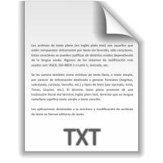
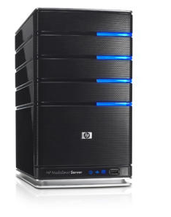

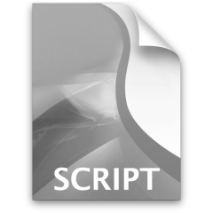



ISIS specific
Live event processing
Broadcast
Listener
Autoreduce
Candidates
Direct inelastic
Powder diffraction
Reflectometry
ISIS autoreduce scripts
Server
Results storage
ICAT upload?
Settings

Slide 5
ICAT
Direct Inelastic
Usage of DGS reduction throughout
Removal of Direct from Convert2Energy interface
Reflectometry
Make Quick Universal for all instruments
Implement Horace syntax for MD operations
Diffraction
Improve SCD user interface?
Muon
To be completed after talking to them

Slide 6
Training
Run Courses (2 new, 2 existing)
Mantid Basics (new)
Introduction to Python
Python in Mantid
Extending Mantid using Python (new)
Open to all
September courses overbooked within 24 hours
Planning another run in November

Slide 7
Others
Office Move
Mantid Paper

